Slide 1
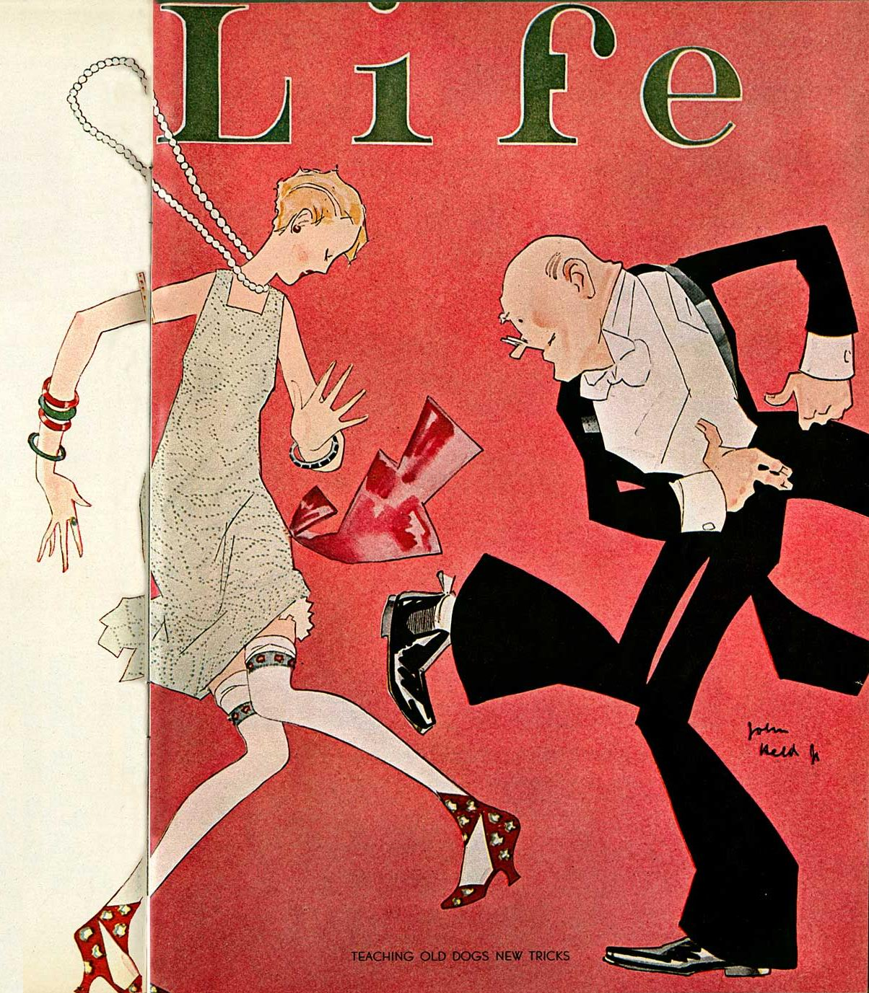
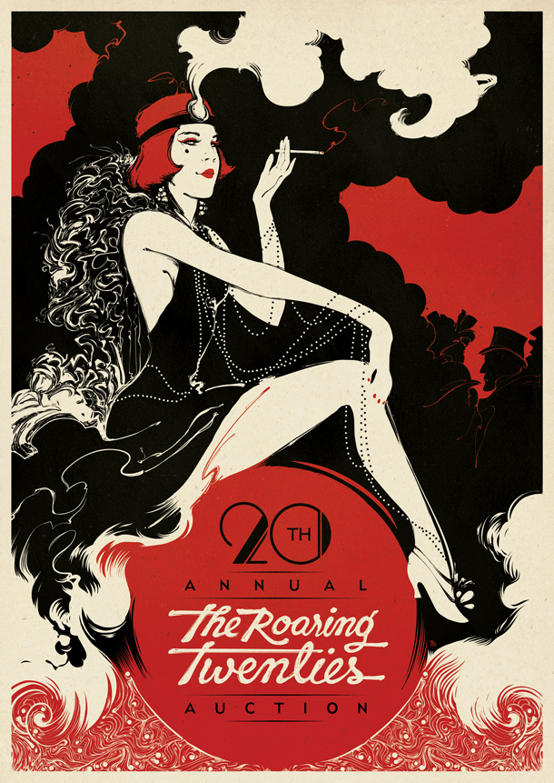
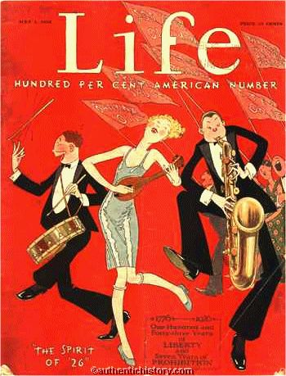
The roaring twenties
CANADA’S SEXIEST DECADE

Slide 2
LEARNING GOALS
By the end of this lesson, students will be able to…
describe some of the reasons why the 1920’s were ‘roaring’
understand how the legacy of WWI affected the 1920’s

Slide 3
Intro to the roaring twenties
A short video presentation

Slide 4
Graffiti page instructions
You are about to watch a short (15 min) video ‘This Century: America’s Time: Boom to Bust’. While the video is American, the content is almost all applicable to Canada at this time as well.
Instructions for viewing:
Find a clean sheet of lined paper
Create a ‘graffiti page’ with terms, names (except US politicians), inventions, fads, themes etc. that you think are reflective of the 1920’s.
You may scatter your terms about in a graffiti styie, or however you prefer to record them
Be prepared to write your terms on the board at the end of the lesson, and to answer the question ‘what made the 20’s Roaring?’

Slide 5
LIKE THIS…

Slide 6
‘This Century, America’s time – boom to bust’
https://www.youtube.com/watch?v=foooDFF9Dgs

Slide 7
On the outside of the good times
Now, read the section in your textbook:
‘WERE THE 1920’S ROARING ECONOMICALLY?’ (pg.64-65)
‘WHAT WAS THE IMPACT OF RESIDENTIAL SCHOOLS?’ (pg.66-67)
make a list of reasons why the 1920’s might not be considered ‘roaring’ for everybody

Slide 8
conclusion
Your task:
Based on the video, do why do you think the 1920’s are called the Roaring Twenties? Write a paragraph using examples from the video to support your answer.

