Slide 1
Trudeaumania!
A ‘Life and Times’ Photo Essay

Slide 2
Learning goals
By the end of this lesson, students will be able to…
Describe the meteoric rise to fame of Pierre Trudeau
Identify the challenges and opportunities in governing Canada in the 1970’s and 80’s
Assess the overall effectiveness of Trudeau’s time as Prime Minsister of Canada

Slide 3
A Visual Essay…

Slide 4
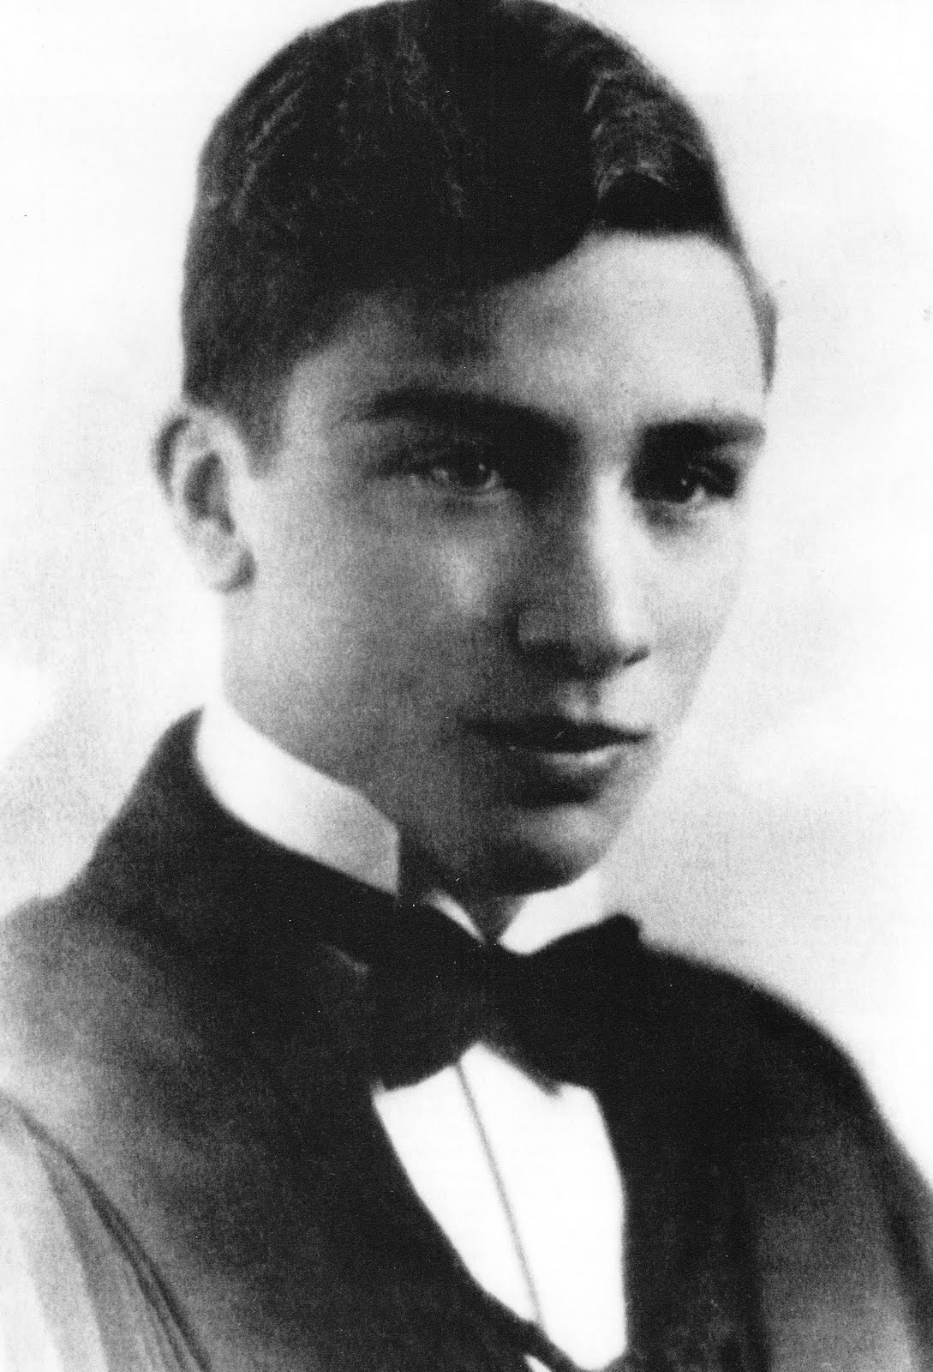
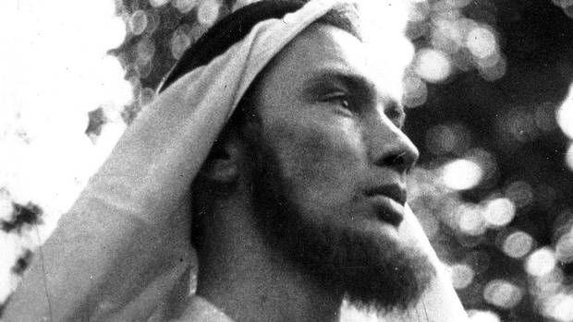

Slide 5
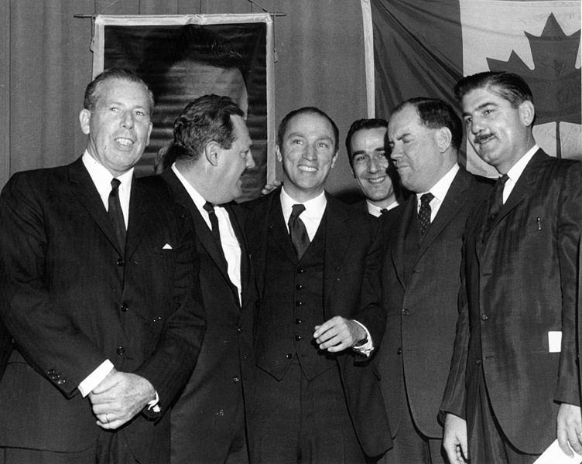

Slide 6
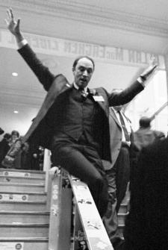
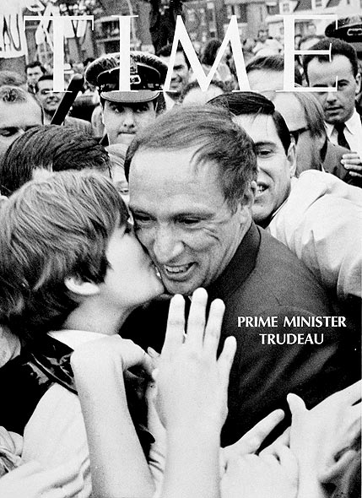
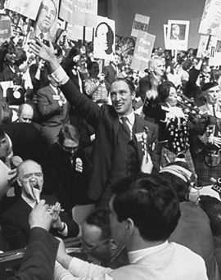

Slide 7
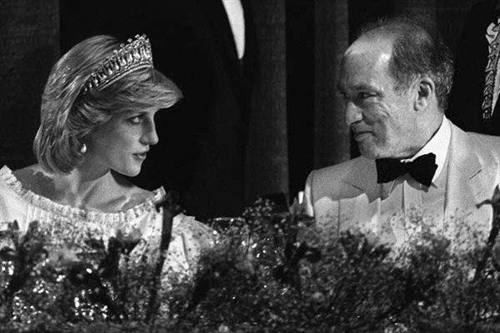
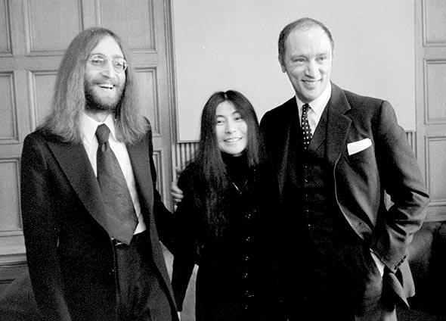
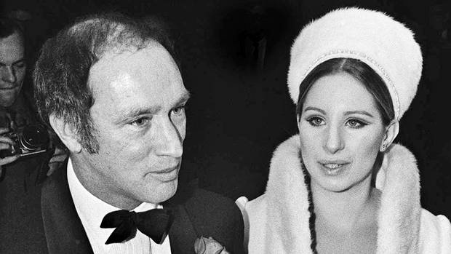

Slide 8
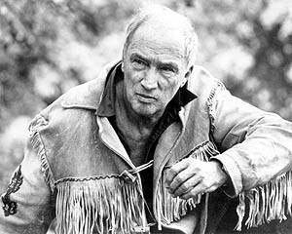
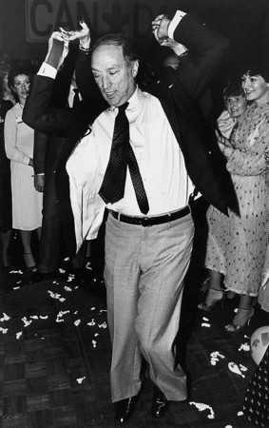
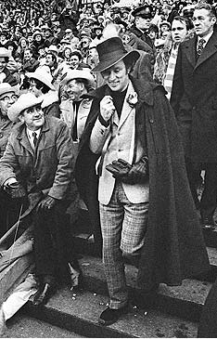
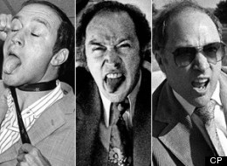
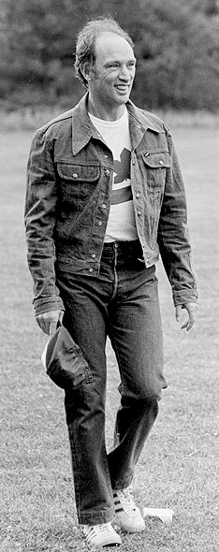
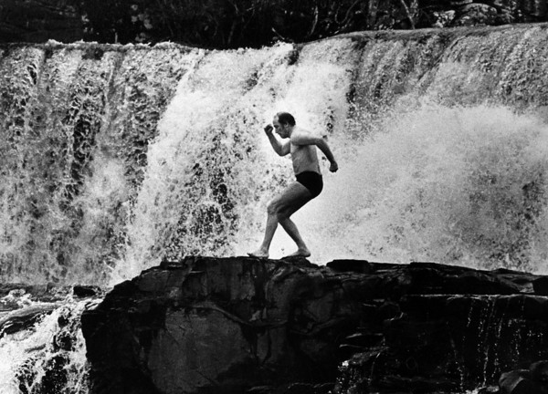
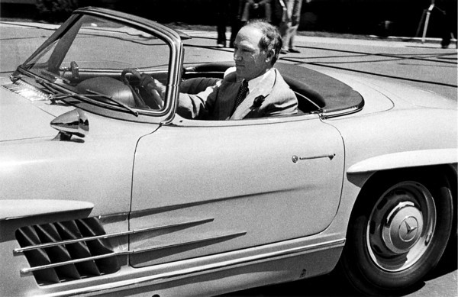

Slide 9
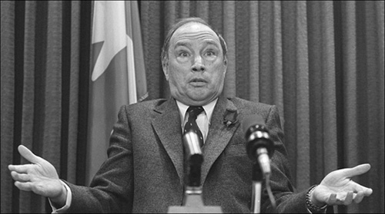

Slide 10
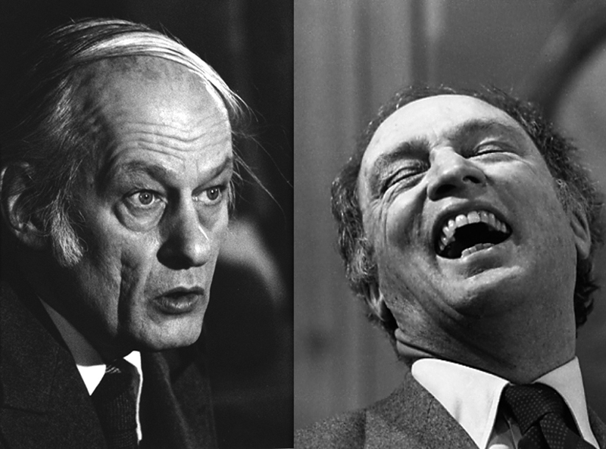

Slide 11
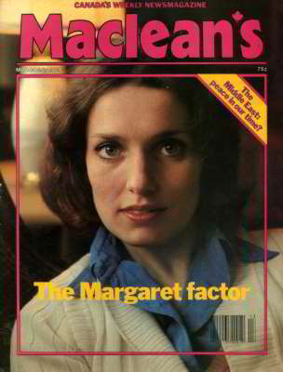
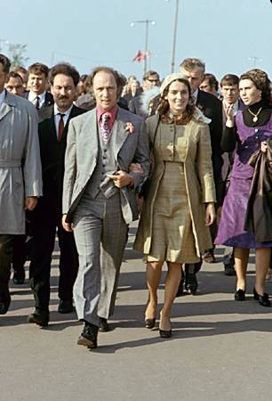
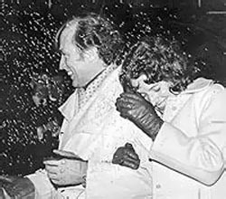
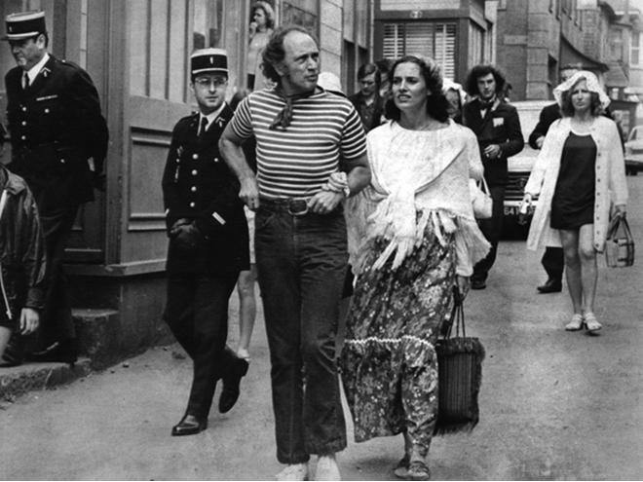

Slide 12
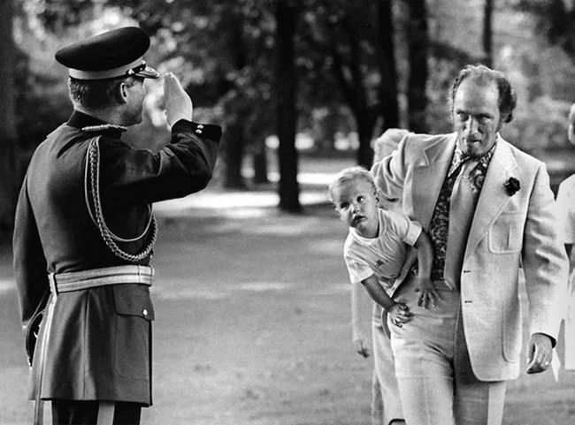
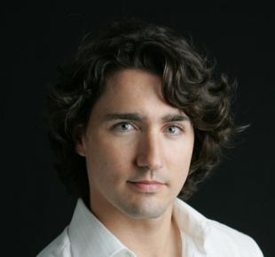
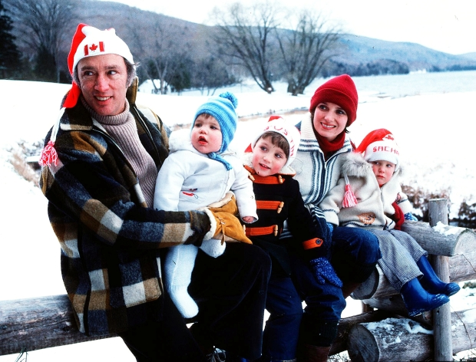

Slide 13
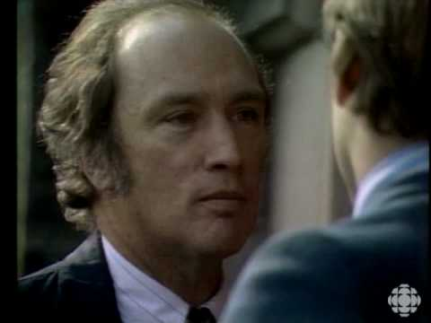

Slide 14
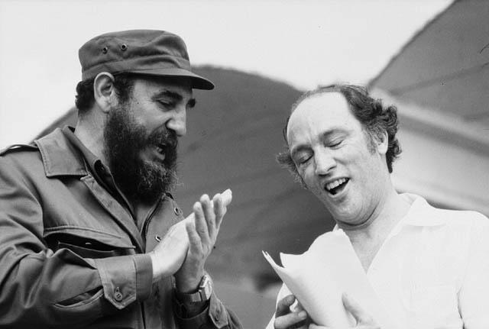

Slide 15
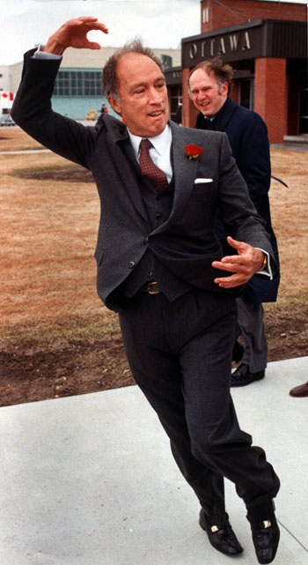
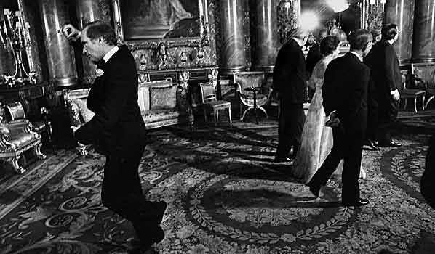
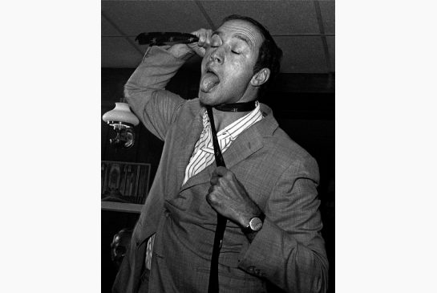

Slide 16
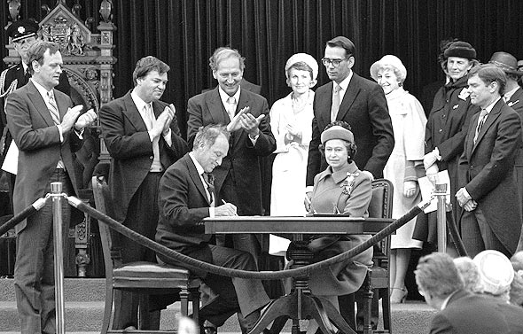

Slide 17
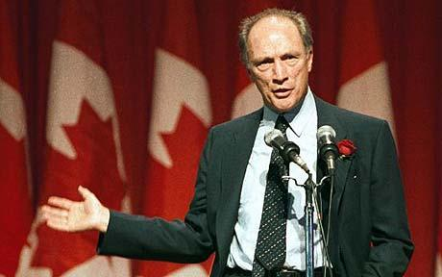

Slide 18
Note-taking guide
-PIERRE ELLIOT TRUDEAU – Life and Times
Plus (positive) | Minus (negative) | Interesting
- - - - - - - | - - - - - - - | - - - - - - -
Overall assessment:

Slide 19
1919 Born on October 18 to a wealthy, bicultural family in Montreal.
1940–1948 Studies political science, economy and philosophy at the universities of Montreal and London, at Harvard and at the Sorbonne in Paris, and returns to Montreal to practice law.
1965 Is elected to Parliament as the Member for Mount Royal, Montreal.
1967 Is appointed Minister of Justice and reforms the Criminal Code, decriminalizing homosexuality and abortion.
1968–1979 Serves as Prime Minister in three successive governments.
1970 Invokes the War Measures Act in response to political violence in Quebec.
1971 Marries Margaret Sinclair, with whom he has three sons. Some years after his divorce in 1984, he has a daughter with lawyer Deborah Coyne.
1979–1980 Serves as Leader of the Opposition.
1980–1984 Returns to power as Prime Minister for a fourth term. Implements major constitutional reforms.
2000 Dies on September 28 in Montreal.

