Slide 1
Torture and Execution in the Modern Era
New Methods, Same Results

Slide 2
What is Capital Punishment?
The facts:
Definition:
punishment of death for a crime; death penalty
Crimes that warrant the death penalty are called ‘capital crimes’ (ex. murder, rape)
Wikipedia estimates that 58 countries still practice capital punishment in the world
The UN (United Nations) has been trying to end it, along with Amnesty International
Interesting fact – as recent as WWI most countries executed their own soldiers for cowardice

Slide 3
For Debate:
Come up with a pro’s and con’s list about Capital Punishment
PRO’S (in favour of it)
-
-
-
-
-
-
CON’S (against it)
-
-
-
-
-
-

Slide 4
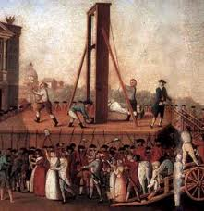
Changing Technologies of Death
The Guillotine
First used during the French Revolution (1789) in France
King Louis XVI and his wife Marie Antoinnette executed
Purpose was to make execution more ‘humane’
10’s of thousands of French citizens eventually executed for ‘crimes against liberty’
http://www.youtube.com/watch?v=lo5BBHtn4tM

Slide 5
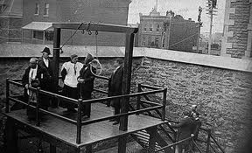
Changing Technologies cont’d
Hanging
Began largely in the 1800’s throughout the British Empire (Canada included)
‘long drop’ seen as more humane than ‘short drop’ (much quicker)
Neck would be broken cleanly with the force of the drop
Last execution in Canada (by hanging) was in 1962
What do the people on the rooftop and the telegraph pole suggest to you?

Slide 6
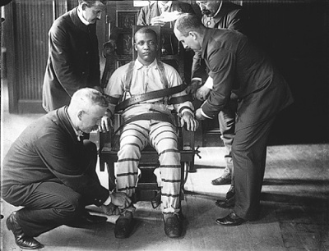
Modern Day Execution
Electric Chair
Committees in the U.S. in the late 1800’s came up with it as a more ‘humane’ execution
Convict is strapped to a chair, various cycles of current are passed through the body
Brain goes dead first, next go the vital organs
Caused severe suffering and burning in some cases
Still used today in at least nine U.S. states
Why would so many straps be needed?
http://www.youtube.com/watch?v=Tb44FHAeKto

Slide 7
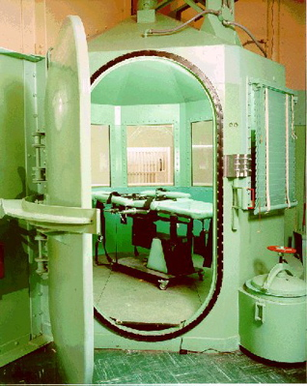
Modern Day Execution cont’d
Gas Chamber
First used in the U.S. in Nevada, 1924
Hydrogen cyanide gas enters chamber
Best if inhaled deeply immediately, otherwise brutal suffering may ensue
Still used today in the U.S.

Slide 8
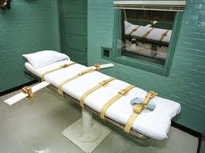
Modern Day Execution cont’d
Lethal Injection
First used in 1977 in the U.S.
Seemed the most humane way to execute
Convict hooked up to IV and given 3 drugs
Potential for severe pain and suffering if 1st drug doesn’t work
Still in use in several U.S. states today
http://www.youtube.com/watch?v=SfEwxhOn0Iw&feature=related
http://www.youtube.com/watch?v=2DrpO_ato6w&feature=fvst

Slide 9
Your Task:
NEXT, WRITE A PERSUASIVE PARAGRAPH ABOUT THE USE OF CAPITAL PUNISHMENT IN THE MODERN WORLD:
“DOES THE DEATH PENALTY CONSTITUTE TORTURE? IF SO, SHOULD THE DEATH PENALTY BE ABOLISHED? IF NOT, WHY NOT?”

