Slide 1
The Colosseum
Rome’s Arena of Death

Slide 2
Learning goals
By the end of this lesson, students will be able to:
understand why the Colosseum was built
describe the role the Colosseum played in Roman society

Slide 3
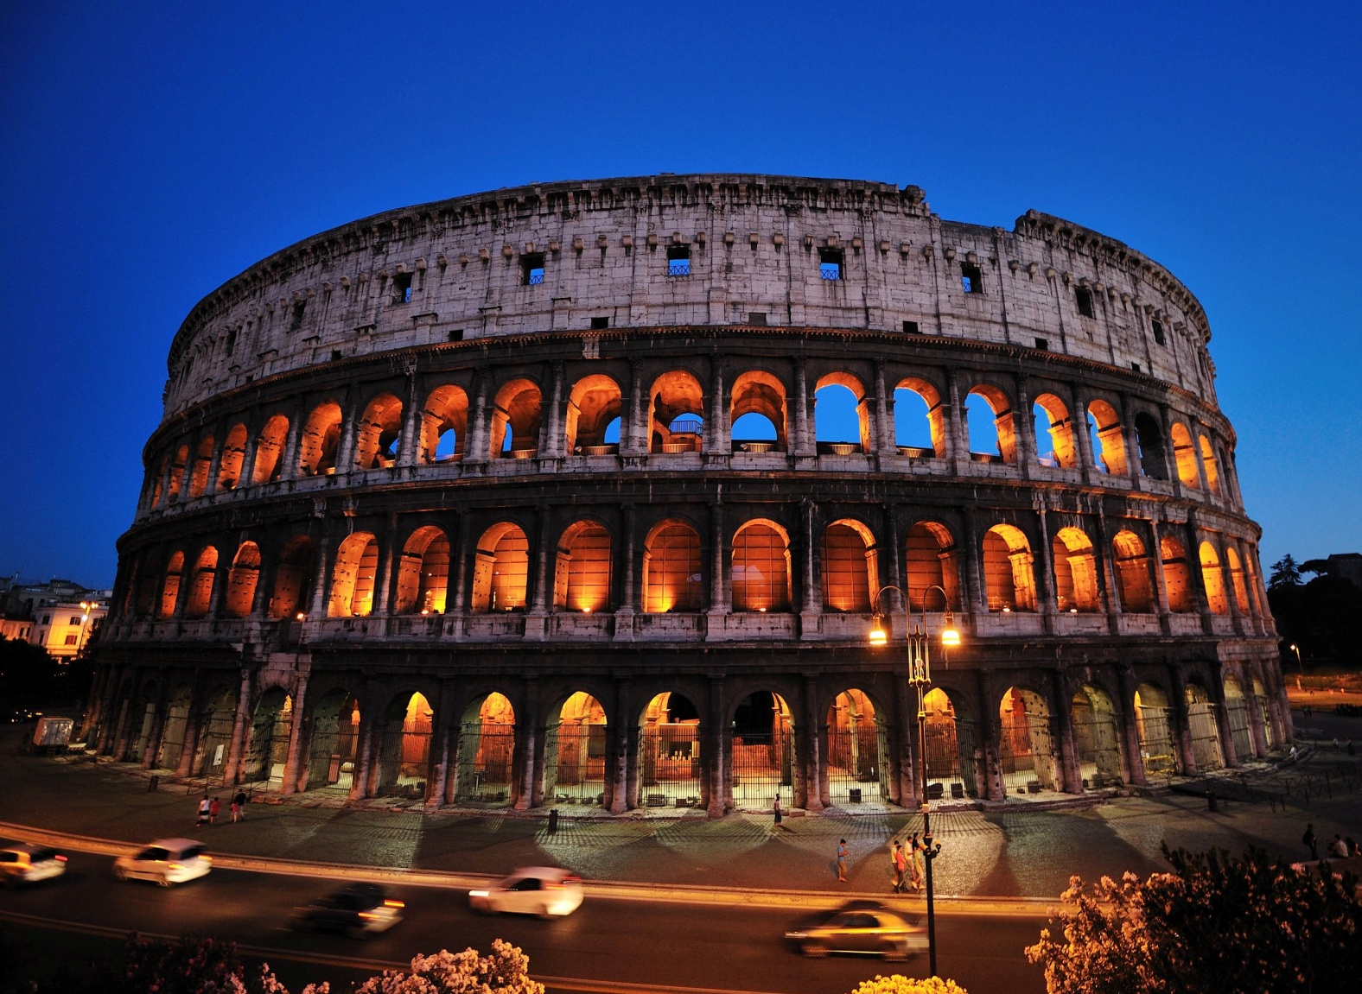
How does it stack up?

Slide 4
Wembley Stadium, London, England
Quick Facts:
Re-built in 2007 (originally in 1923)
Capacity: 105,000 (seated and standing)

Slide 5
The Big House (University of Michigan Football Stadium), Ann Arbor, Michigan, USA
Quick Facts:
Built in 1927
Capacity: 111, 000

Slide 6
Cowboy Stadium, Dallas, TX, USA
Quick Facts:
Built in 2009
Capacity: 110, 000 (seated and standing)
Cost: $1.15 billion

Slide 7
The Flavian Amphitheatre (Colosseum)
Quick Facts:
Located in Rome, Italy
Capacity: 50, 000
Built in 79-80 CE
Started by Emperor Vespasian, finished by his son Emperor Titus

Slide 8
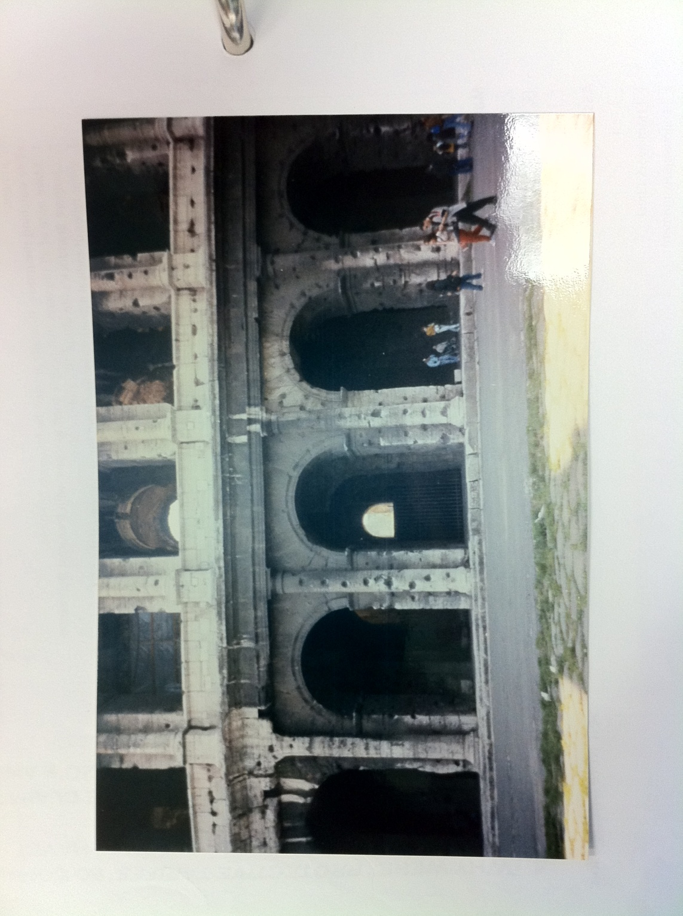
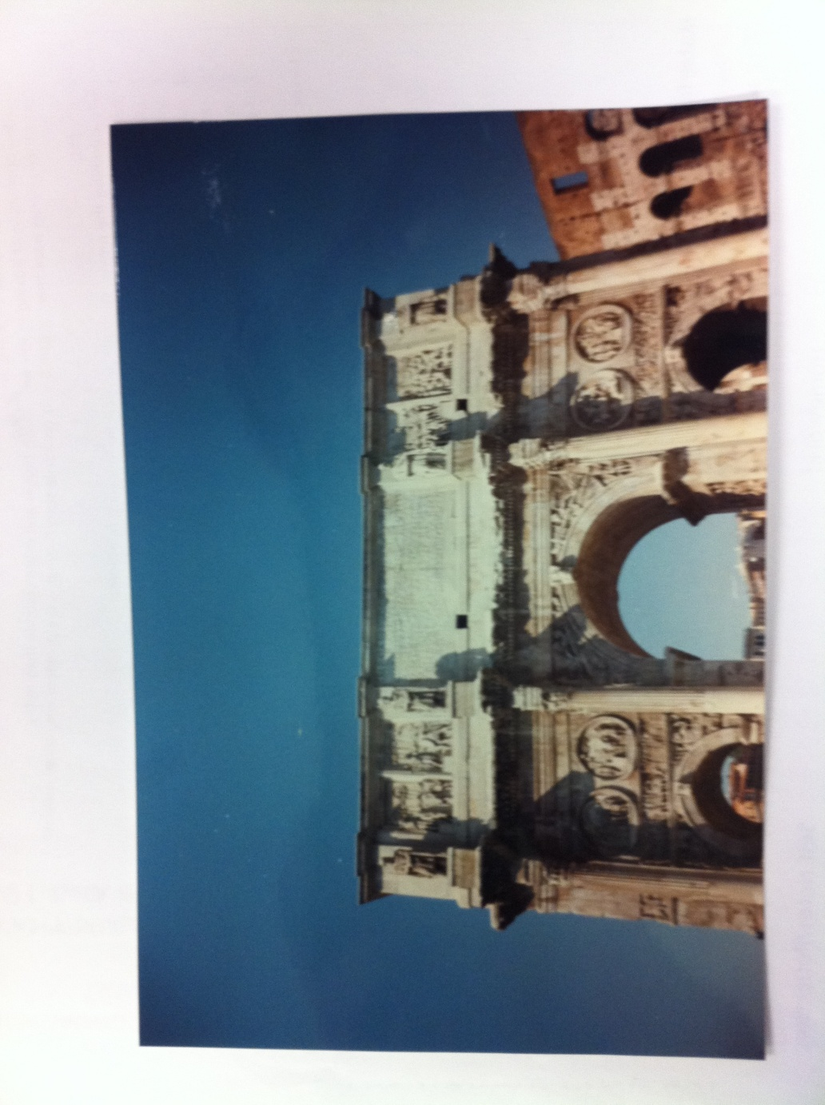
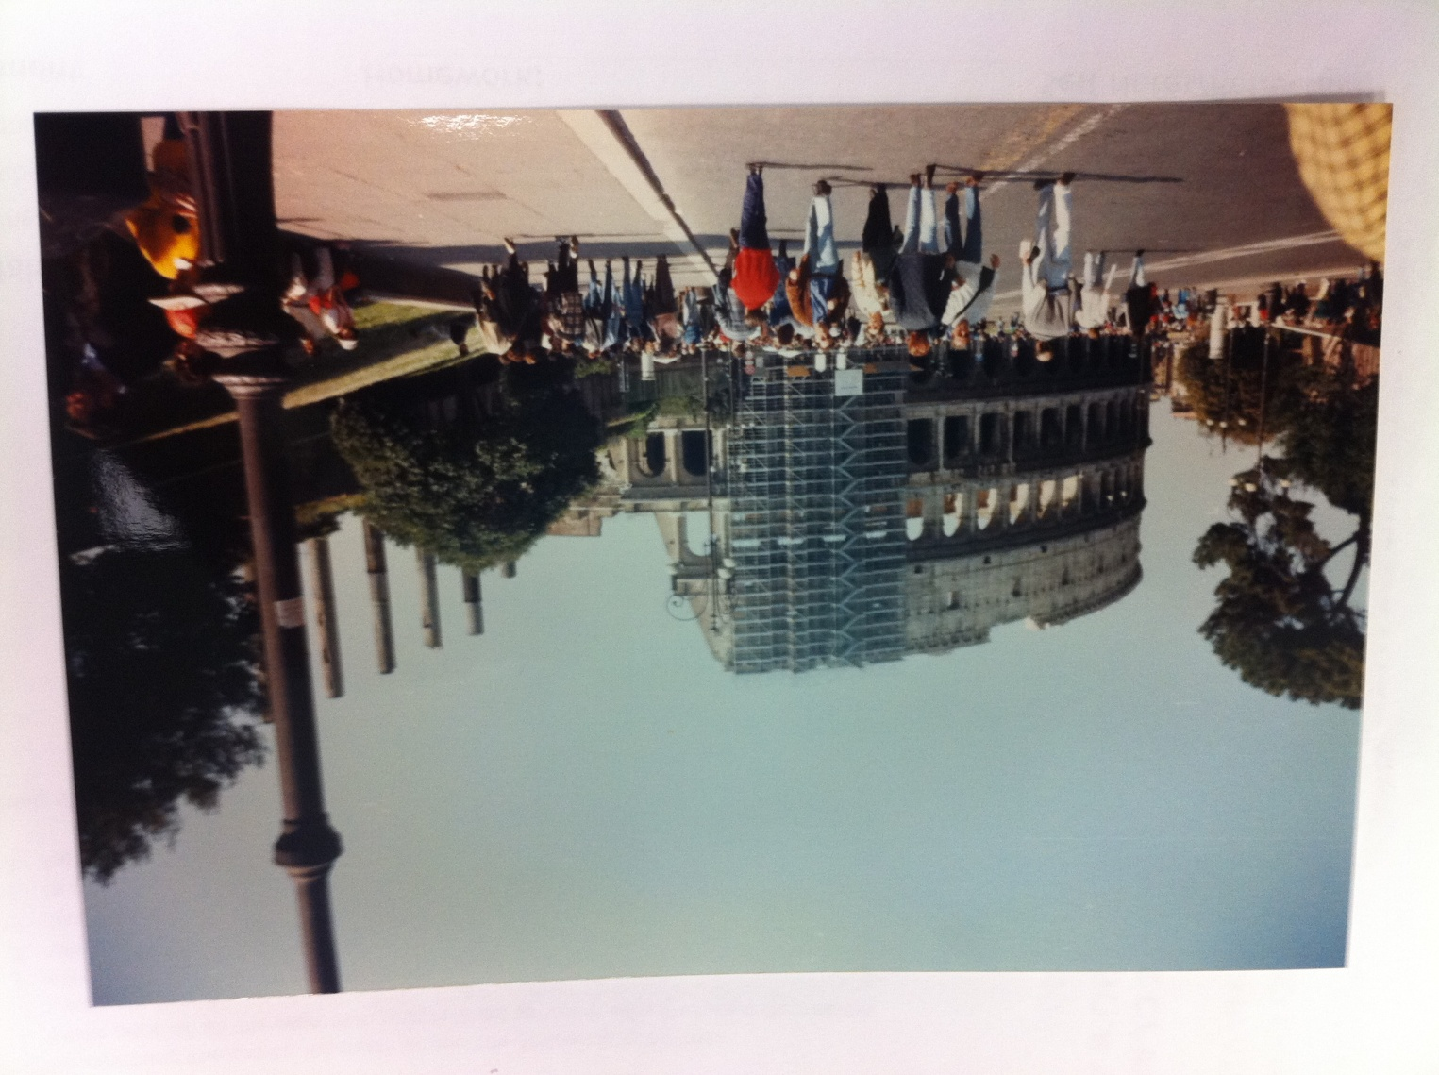
My Trip to Rome
April, 1997

Slide 9
The Arena of Death
Form and Function of the Colosseum

Slide 10
Refer to the video question sheet
https://www.youtube.com/watch?v=4WphJnTNGPM

Slide 11
Use your handout to complete the diagram
http://www.bbc.co.uk/history/ancient/romans/launch_ani_colosseum.shtml

