Slide 1
The roaring twenties
CANADA’S SEXIEST DECADE

Slide 2
LEARNING GOALS
By the end of this lesson, students will be able to…
describe some of the reasons why the 1920’s were ‘roaring’
understand how the legacy of WWI affected the 1920’s

Slide 3
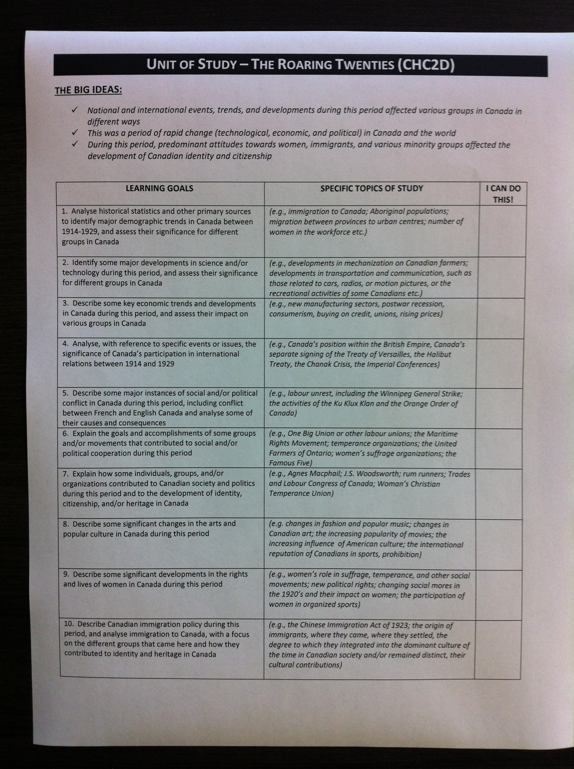
Unit Learning goals
Please refer to your handout…

Slide 4
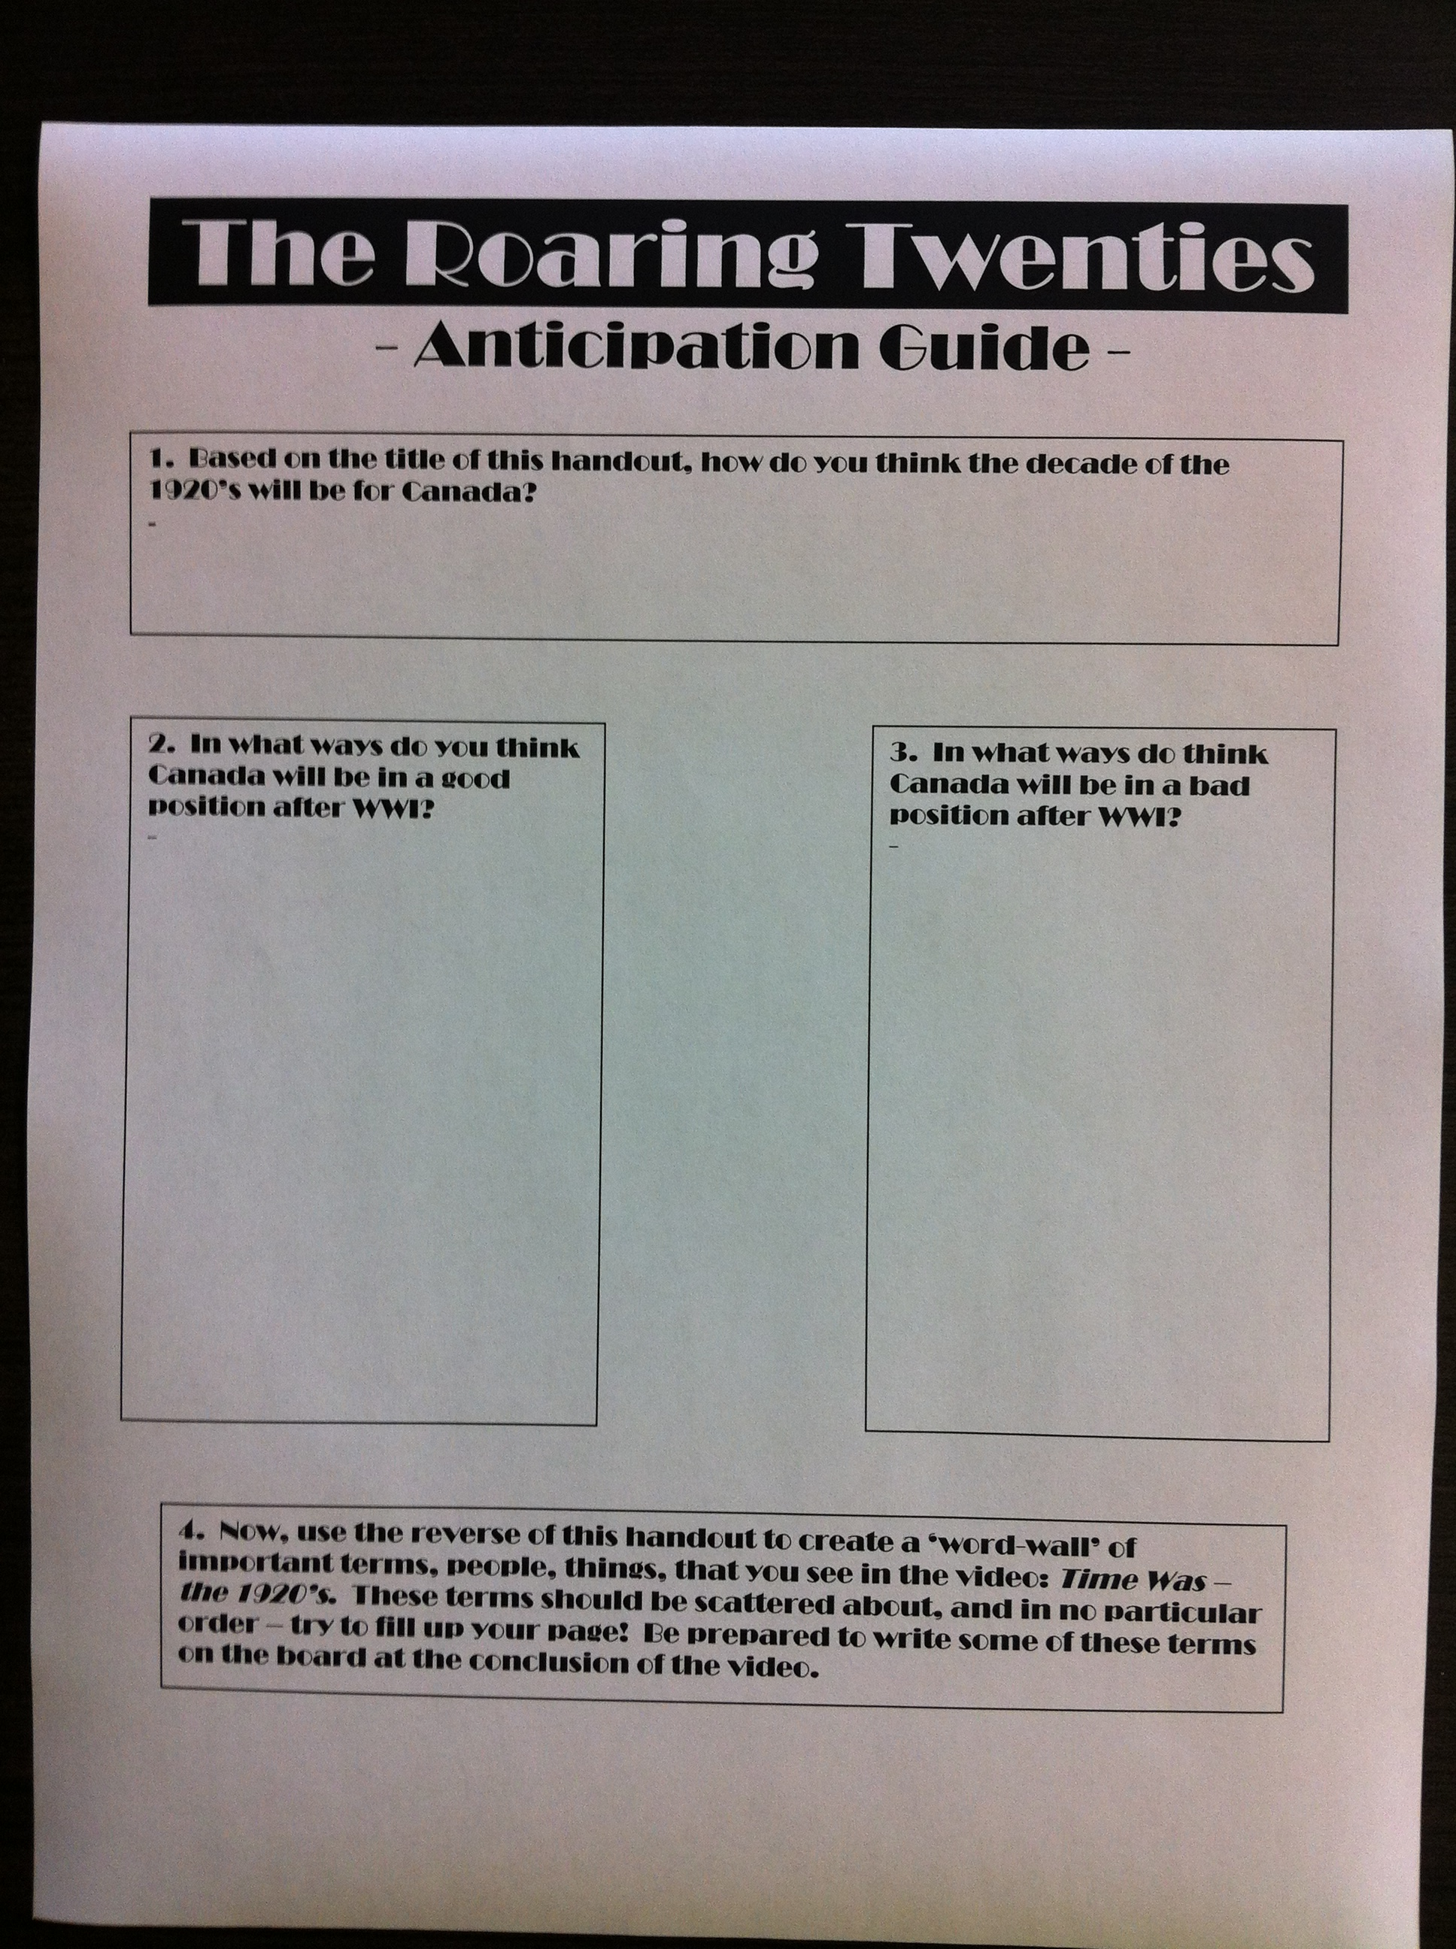
Anticipation guide
Please refer to the handout…

Slide 5
Intro to the roaring twenties
A short video presentation

Slide 6
Crash course world history
You are about to watch a short (13 min) video ‘Crash Course World History – the Roaring Twenties’. While the video is American, the content is almost all applicable to Canada at this time as well.
Instructions for viewing:
Find a clean sheet of lined paper
Create a ‘graffiti page’ with terms, names (except US politicians), inventions, fads, themes etc. that you think are reflective of the 1920’s.
You may scatter your terms about in a graffiti styie, or however you prefer to record them
Be prepared to write your terms on the board at the end of the lesson, and to answer the question ‘what made the 20’s Roaring?’

Slide 7
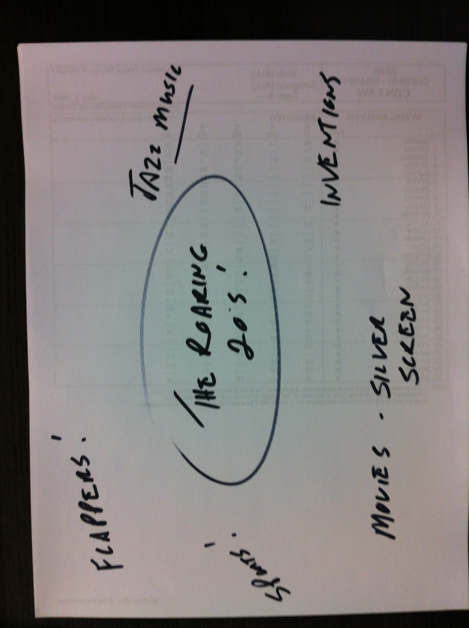
LIKE THIS…

Slide 8
Crash course world history – the roaring twenties
https://www.youtube.com/watch?v=VfOR1XCMf7A

Slide 9
conclusion
Your task:
Based on the video, do why do you think the 1920’s are called the Roaring Twenties? Write a paragraph using examples from the video to support your answer.

