Slide 1
History’s Most Infamous Pirates
Captain William Kidd
“This wicked-gotten treasure doth him but little pleasure”

Slide 2
Learning goals
By the end of this lesson, students will be able to…
Describe the life and crimes of Captain William Kidd
Determine if Kidd deserved his fate
Understand the fine line between pirates and privateers

Slide 3
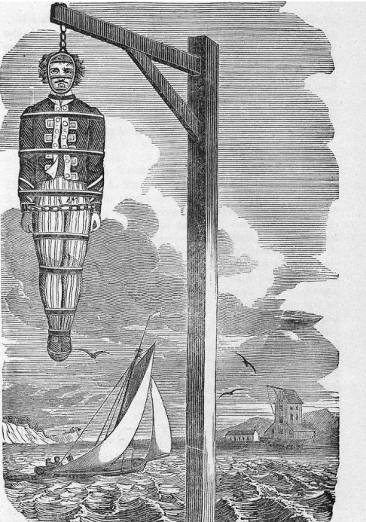
Background
Beginning in 1701, every ship sailing into London would have passed Kidd’s corpse
His body was tarred, and hung from a ‘gibbet’ over the Thames River (Execution Dock) as a warning to all ‘would-be’ pirates
“He was probably the unluckiest man to ever sail under the British flag”

Slide 4
Kidd’s Early Career
Born in Scotland in 1645
Father was a Presbyterian minister
Led a mutiny against the captain of the Pirate ship Blessed William
Was granted a privateering license by King William III in 1695 to hunt down pirates like Thomas Tew
Negotiated assistance from some high-ranking officials in British parliament for a 10% kickback

Slide 5
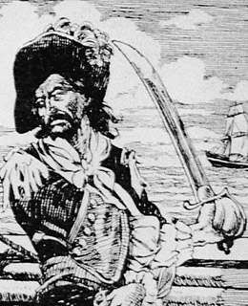
Kidd Turns Pirate
Kidd purchased a ship called Adventure Galley
Recruits a ragbag crew of scoundrels
Supposed to privateer but they want to plunder
Killed one of his gunners – William Moore
Needed plunder to keep his men happy
Pirated small ships in the Indian Ocean – who would notice???

Slide 6
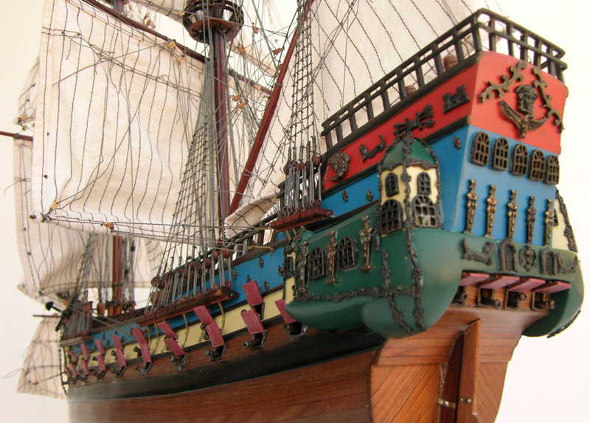
The Quedagh Merchant
In 1698 Kidd captures the Quedagh Merchant
Steals cargo of satins, gold, silver…
But this was ship belonged to the British East India Company! – an important trade partner of the British gov’t
Kidd flew a French flag but was actually working for British - controversy

Slide 7
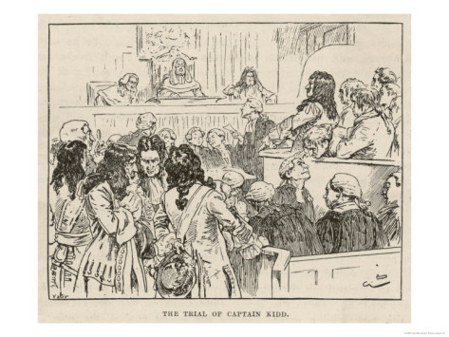
Arrest, Trial, and Execution
Upon his return to New York, Kidd is arrested
Hoped his powerful friends would support him – didn’t
Spend 2 years in captivity, tried, executed, hung-up in a gibbet
Couldn’t find his papers that showed he had the right to seize the ship
But…was it a mistrial???

Slide 8
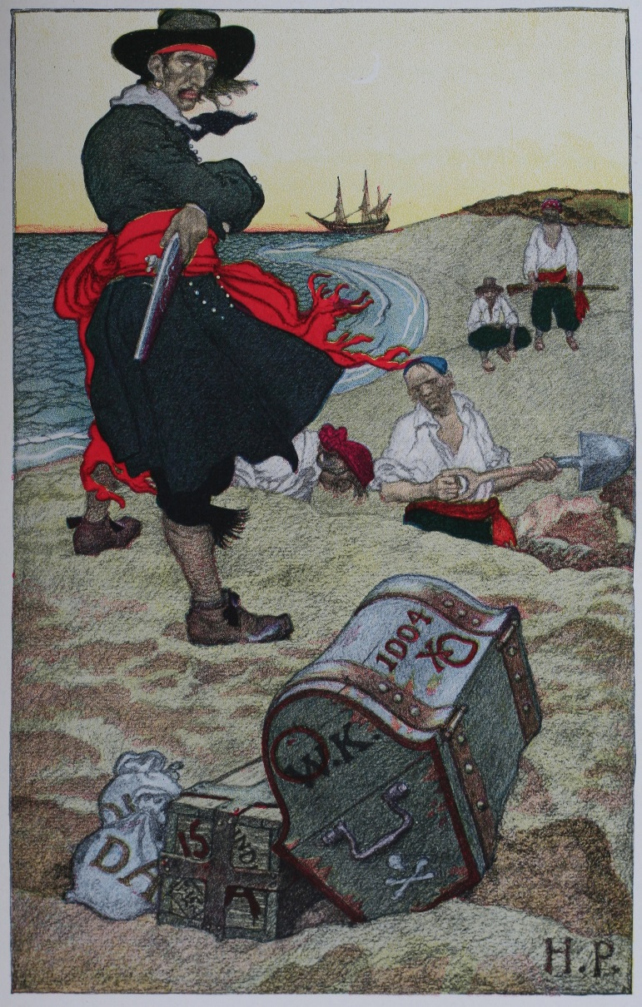
Burried Treasure???
Rumours spread that Kidd buried a treasure worth 400,000 British pds. (approx. $87 million CDN)
Never found…
‘This wicked-gotten treasure doth him but little pleasure’

Slide 9
So…was Kidd given a fair trial? Watch the video: Mystery Files and complete the following chart:
Yep, he deserved it | Nope – didn’t deserve it
- - - - (try for 4 points on each side) | - - - -
Now, use the above points to write a short paragraph below explaining whether or not you feel Captain Kidd deserved his fate.

