Slide 1
Effects of the Great Depression
CHC2P
Hard Times for Canadians

Slide 2
Learning Goals
By the end of today’s lesson, students will be able to…
describe the effects of the Great Depression on various regions in Canada
assess the governments response to the Great Depression

Slide 3
Minds-on
Question:
If times were so tough during the Great Depression, why did parents keep having so many kids???
Your thoughts?
Kids were sources of labour and often would work on the farm rather than go to school
Big families were the norm
But there is another reason…
At this time it was illegal to advertise birth control measures. If caught, you could be imprisoned for up to 2 years!!!

Slide 4
Introduction
After the Stock Market Crash of 1929, Canadians were forever changed
People stopped trusting…banks, employers, the gov’t
Plus a number of other factors combined to make things even worse…

Slide 5
Workers in the Cities
Many Canadians had prospered in the cities during the 1920’s
Some managed to keep their jobs in the 30’s – but most had to take pay cuts
Most were expected to produce more, while making less $$$
As production slowed, layoffs increased

Slide 6
Farmers in the West
Farmers were hit hard during the GD
The price of wheat dropped
The region of the Prairies known as the Palliser Triangle was hit the worst
Nearly 14,000 farms were abandoned (see graphic)
Plus a number of other factors…

Slide 7
Primary Source Analysis
What conclusions can we make by examining this map?
Think about:
what do the arrows represent?
is there a trend that you notice?
how does it relate to what we are studying?

Slide 8
Canada: A People’s History
VIDEO BREAK!!!
Episode 13: Hard Times (35:10)
https://www.youtube.com/watch?v=AQdSR7RD3rU&safe=active

Slide 9
The Dust Bowl
Many Prairie farmers faced natural disasters
Drought in 1929 – lasting nearly 10 years!
Infestations of insects that ate crops (grasshoppers)
Soil had been over-farmed…no nutrients left
Prairies became known as the ‘Dust Bowl’ as the soil dried up

Slide 10
Who was hit hardest?
Decline in Average Annual Incomes
Province | 1928-29 | 1933
Alberta | $548 | $212
B.C. | $594 | $314
Manitoba | $466 | $240
New Brunswick | $292 | $180
Nova Scotia | $322 | $207
Ontario | $549 | $310
PEI | $278 | $154
Quebec | $391 | $220
Saskatchewan | $478 | $135
What conclusions can you make?
Did anyone notice there is a province missing?

Slide 11
Governing Canada
Challenges of the 1930’s

Slide 12
Changing Attitudes Towards our Government
The 1930’s were the worst 10 years in Canadian history!!!
Government officials had to change their policies – or be voted out!
People demanded social programs like welfare and medical care

Slide 13
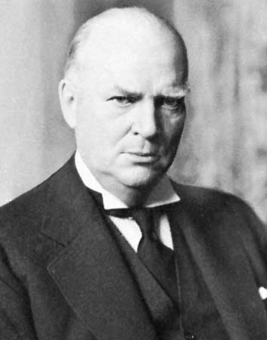
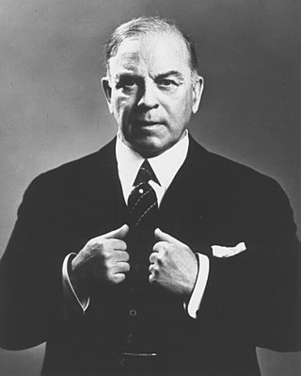
Canada’s Prime Ministers
Mackenzie King, Liberal
R.B. Bennett, Conservative
Prime Minister most of the 1920’s till 1935
Believed Stock Market Crash not a big deal
Did little to help rising unemployment
Lost election of 1935
Defeated King in 1935 election
Promised to find work for all Canadians
Had no plan for dealing with Depression though
Gave money in form of ‘relief’ to the provinces

Slide 14
Canada a People’s History
Refer to the question sheet while watching the video
https://www.youtube.com/watch?v=AQdSR7RD3rU&safe=active

