Slide 1
CLU3M
UNIT 3: CRIMINAL LAW

Slide 2
LEARNING GOAL
By the end of this lesson, students will be able to…
explain how a criminal offence is defined in Canada;

Slide 3
What’s in the News?

Slide 4
Minds On: Can you solve the mystery?
This is a story about a girl. While at the funeral of her own mother, she met a guy whom she did not know, but was part of her family. She thought this guy was amazing, so much her dream guy she believed him to be, that she fell in love with him there but never asked for his number and then a few days later the girl killed her own sister.
Question: What is her motive in killing her sister?

Slide 5
Answer:
The girl wanted to see the man again, but couldn’t since she did not have his number. Since he was somehow connected to the family, he would presumably show up at her sister’s funeral too…
This is a diagnostic test to determine if someone is a serial-killer. I will need to speak to you privately if you got it correct…

Slide 6
A CRIME is any act or omission of an act that is prohibited and punishable by federal statute
Omission of an act means some crimes are your failure to act in certain situations that you should have
Ex. Failure to stop at the scene of an accident you were involved in

Slide 7
The following (4) conditions must be present for an act or omission to be considered a crime:
1. The act is considered wrong by society
2. The act causes harm to society in general or those in need of protection
3. The harm is serious
4. The remedy must be handled by the criminal justice system.

Slide 8
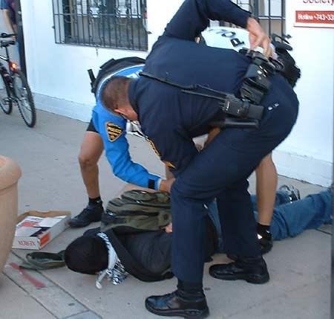
A CRIME is considered to be an offense against the victim and society as a whole
Criminal law is the body of laws that prohibit and punish acts that injure people, property, and the entire community.
The purpose of criminal law is to:
Protect people and property
Maintain order
Preserve standards of public decency

Slide 9
A federal statute that contains the majority of the criminal laws passed by Parliament
1st est. in 1892 by Sir John A. Macdonald
It lists the offences, the sentences to be imposed, and the procedures to follow when trying those accused of crimes
Applies equally to all Canadians
Occasionally amended to reflect changing values in Canadian society (ex. gun laws from the 1800’s may no longer apply…)
Examples of other federal acts that contain criminal laws:
http://laws-lois.justice.gc.ca/eng/acts/

Slide 10
Administration of the criminal justice system is shared between the federal and provincial governments
Federal government makes laws for all of Canada but provincial courts handle the cases
Provinces and municipalities do make criminal laws in their area of jurisdiction such as traffic and liquor control and are known as quasi-criminal laws
Quasi-criminal laws are laws covering less serious offences at the provincial or municipal level; most often punishable by fines

Slide 11
Video Break…
Add to the notes you have already taken while watching the following video: https://www.youtube.com/watch?v=DfgSAsg0Wv4a
A good guideline for notetaking is a point per minute. Use this heading:
‘Intro to Criminal Law’ - video
-
-
-
-
-

