Slide 1
CLU3M – Introduction to Canadian Law
What is Law?

Slide 2
Learning Goal
By the end of this lesson, students will be able to…
Define law
Explain how law is important to society
Describe the components of good rules/laws
Explain the difference between a rule and a law
Understand the concept of ‘rule of law’

Slide 3
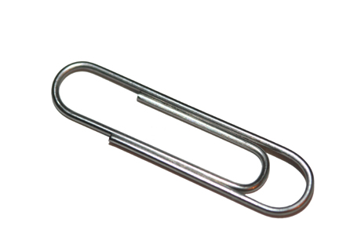
THE PAPER CLIP GAME
LETS PLAY

Slide 4
Write this Down!
LAW AND SOCIETY
All human activity requires rules to ensure fairness
Without rules or laws, we would live in chaos and confusion
There are 4 components to good rules/laws, they must:
Be Fair
Be Consistent
Be Clear
Have purpose

Slide 5
Law is Everywhere!
read through the scenario titled Law is everywhere and highlight or underline all the times during the day that the main character encounters the law.
We'll take it up together

Slide 6
Write this down!
Why Should We Study the Law?
To ensure the legal system continues to work
Allows citizens to affect meaningful change
Helps people understand the need for order in society.

Slide 7
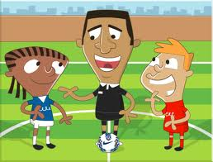
Keep Writing!
Rules vs. Laws
Rules: Not created by the government and not enforced by the government. They apply to specific people in specific places. Ex. No hats in school
Laws: A set of rules created by and enforced by the government. They apply to everyone equally. Ex. Speed limits

Slide 8
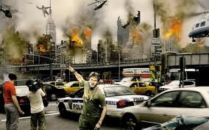
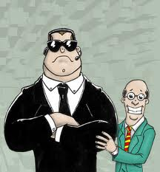
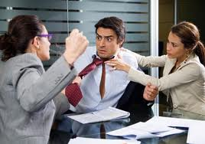
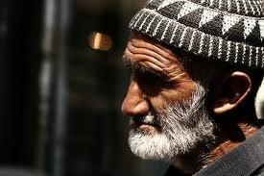
Still Writing!
Why do we need laws?
Predictability, and structure in society
Safeguard for persons and property
Settle disagreements peacefully
Protect the rights of citizens (might=right)

Slide 9
Last bit...for now
The Rule of Law
The Rule of Law is a theory or philosophy that underlies our entire justice system
The Rule of Law has 3 important parts:
1. Law is necessary in an orderly society
2. The law is applied equally to everyone (aka – no one is above the law)
3. A person's legal rights will not be taken away except in accordance with the law (or we are not governed by an arbitrary(random) power)

Slide 10
Are Celebrities Above the Law?
Amanda Bynes is taking her DUI case straight to the Commander in Chief.
On Tuesday, the 26-year-old "What I Like About You" actress was formally charged with driving under the influence of alcohol or drugs following an April 6 run-in with a cop car. E! News reports that Bynes is also accused of refusing a police officer's request to complete a chemical test to determine what substances were in her system.
But Bynes isn't going to take her charges lying down. After being charged, she Tweeted President Barack Obama to plead her case."Hey @BarackObama... I don't drink. Please fire the cop who arrested me," she wrote in a tweet to the President's re-election campaign Twitter account. "I also don't hit and run. The end."
About a month after her her April 6 incident, Bynes was involved in an alleged hit-and-run in Hollywood, according to TMZ. She sideswiped another vehicle while she was trying to pass on the right in her Range Rover SUV. Though the actress continued driving after making contact, she reportedly cooperated with police when they caught up with her, telling authorities she didn't realize she had struck the other car.
An arraignment for Bynes' DUI case is scheduled for Wednesday morning; because it is a misdemeanor charge, only her lawyer is expected in court.

Slide 11
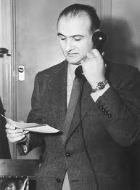
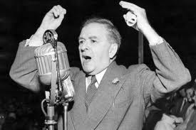
Roncarelli v Duplessis
Read the case study on page 13 in your text and answer the questions – we'll take them up together

