Slide 1
WWI THE GREAT WAR

Slide 2
Learning goals:
By the end of this lesson, student will be able to:
identify the MAIN causes of World War I
distinguish between direct and indirect causes
explain how international events affected Canada

Slide 3
Minds-on
Consider the following story of Casey:
In September, Casey drove through an intersection and was killed in a car crash. The police officer investigating the accident noted the night fog and wet, slippery road on the report. Casey had left the party at 2:00 am in an agitated state, but none of the friends at the party attempted to stop Casey from getting behind the wheel. Casey had recently failed university. That failure really disappointed Casey’s girlfriend, and they broke off their engagement.
Now, working with an elbow partner, answer the following questions
1. What were the immediate/direct causes of the accident?
2. What were the underlying/indirect causes of the accident?

Slide 4
The Story of Casey
#1 What casued Casey’s accident? Explain at least three reasons.
#2. What were the ‘indirect’ causes of the accident?
#3. What was the ‘direct’ cause of the accident?

Slide 5
World War I through images
Part I

Slide 6
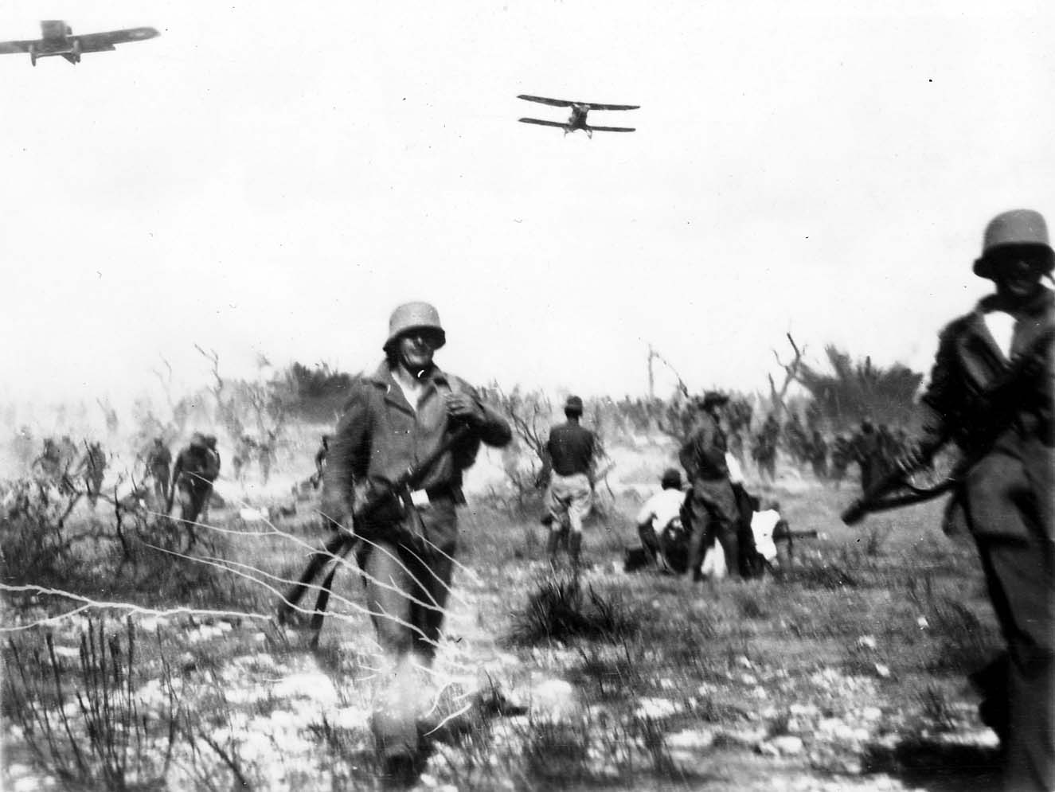

Slide 7
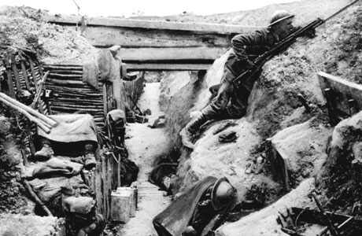

Slide 8
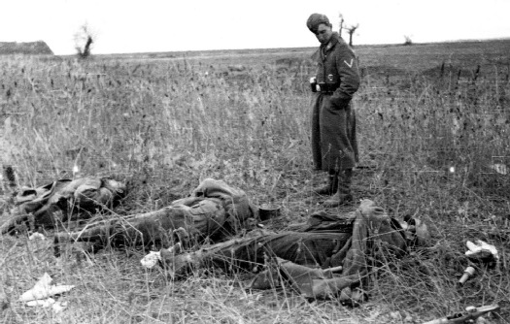

Slide 9
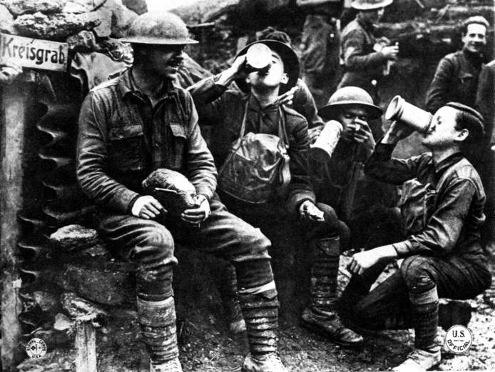

Slide 10
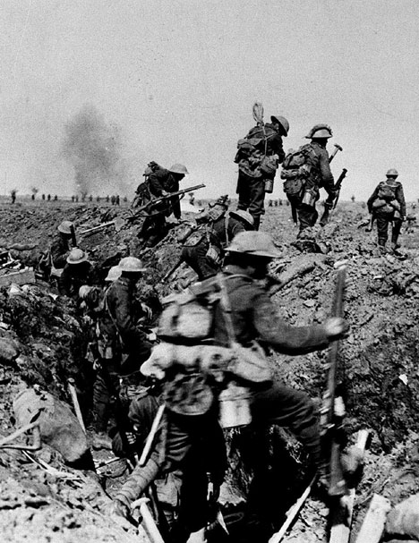

Slide 11
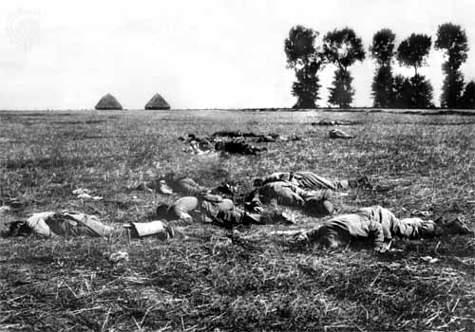

Slide 12
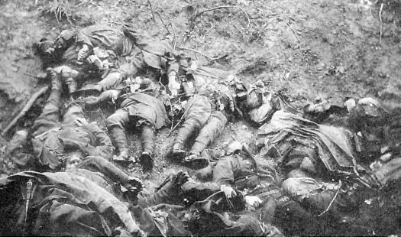

Slide 13
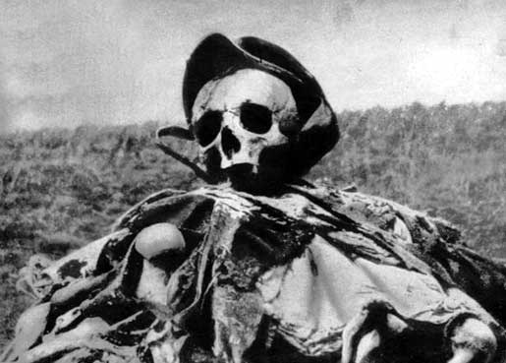
The Real Face of War...

Slide 14
The MAIN causes of WWI
Part II

Slide 15
The MAIN Causes of WWI
M – Militarism: the policy of making a country’s military very strong, so that it threatens others around you.
A – Alliances: when countries make agreements to help each other if one is attacked
I – Imperialism: extending the rule of your country over another country. This was called empire building.
N – Nationalism: an extremely patriotic feeling towards you country – making people willing to die for it .

Slide 16
Now for some more background

Slide 17
M - Militarism
Countries like Germany were trying to build up their military, especially their navy.
Germany was competing with Britain for the largest navy, building dreadnoughts/ battleships and U-boats/submarines.
This created an ARMS RACE – competing for the most military weapons.

Slide 18
A – Alliances System
There were two major alliances in Europe:
The Triple Entente – “The Allies”:
Britain (including Canada and the rest of the British Empire)
France
Russia
The Triple Alliance – “The Central Powers”:
Germany
Austria-Hungary
Italy

Slide 19
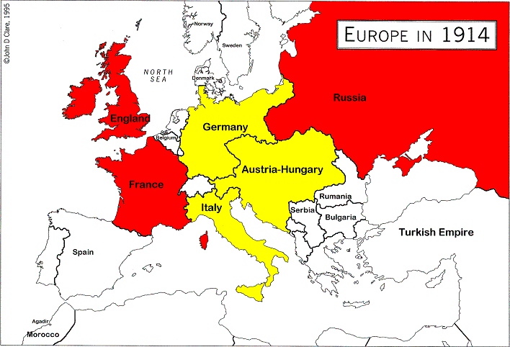
Pre-WWI Map of Europe

Slide 20
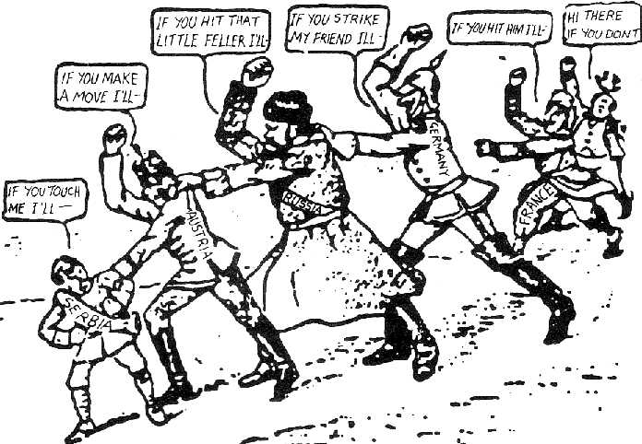
A Comic Look at how Alliances work...

Slide 21
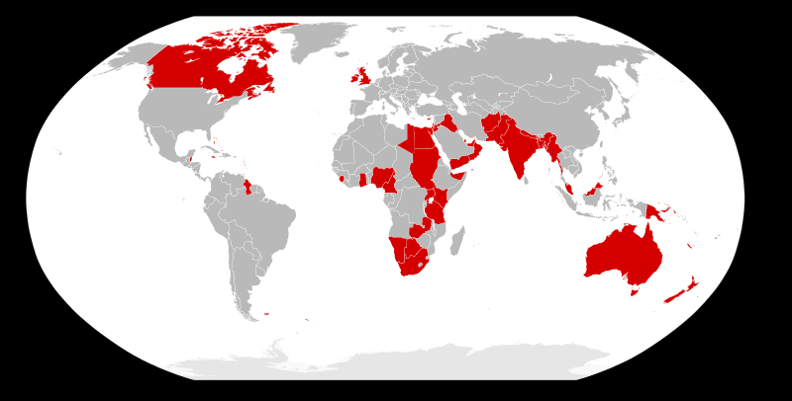
I = Imperialism
At the turn of the century, all the great European powers were competing for colonies / territory.
Germany was a relatively new country and began to look for its own colonies to control.
The British, French, and Russians all feared German aggression toward their colonies, creating major tension among the countries.
“The sun never sets on the British Empire . . .”
THE BRITISH EMPIRE c.1900

Slide 22
N = Nationalism
Nationalism combined with imperialism to fuel the European race for overseas colonies. These colonies would bring the mother country great economic wealth, military power, and national pride.
Countries with highly nationalistic populations could easily raise their military and prepare for war.

Slide 23
The spark that started the War
Part III

Slide 24
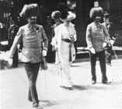
The Assassination…June 28th, 1914
Heir to Austrian (German ally) throne Franz Ferdinand visits Serbia.
Serbia is unhappy about being forced into the Austro-Hungarian empire
Members of a Serbian terrorist group called the Black Hand are plotting an attack…
Seal of the Black Hand group

Slide 25
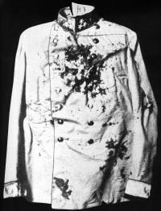
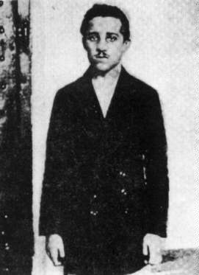
Assassination Cont’d
“Black Hand” terrorists attack the Archduke.
After a bomb attempt fails in morning, nineteen-year-old Gavrilo Princip shoots the Archduke and his pregnant wife later in the afternoon.
Austrians blame Serbia for supporting terrorists.
The Alliance system is engaged

Slide 26
The ‘war to end all wars’ begins… the world would never be the same.

Slide 27
The Early War
Part IV

Slide 28
The Alliance System Deploys
The First World War Begins
1. July 28, 1914 – Austria/Hungary declares war on Serbia
2. July 29, 1914 – Russia declared war on Austria/Hungary
3. August 1, 1914 – Germany declared war on Russia
4. August 3, 1914 – Germany declared war on France
5. August 4, 1914 – Britain and the British Empire declared war on Germany
With German permission (see ‘blank cheque’), Austria-Hungary demands to enter Serbia
Serbia knows this will lead to an all out invasion, and refuses, so…..

Slide 29
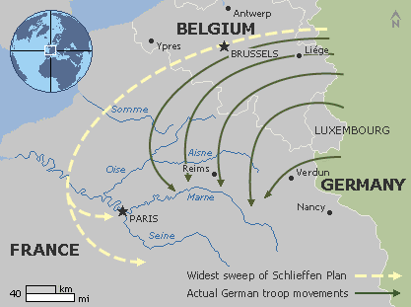
Strategies of War
Germany’s war plan was named the Schlieffen Plan
They wanted a quick attack on France, avoiding their defences, through Belgium
Once France was overwhelmed, they would turn towards Russia
Instead, they became bogged down in France and Belgium in a long war of attrition

Slide 30
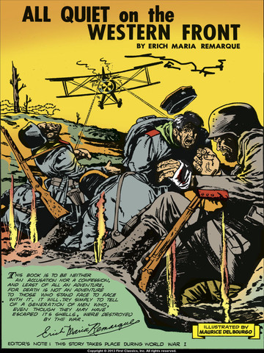
Stalemate
With Britain now in Europe defending France, the two sides reached a ‘stalemate’ – period of little movement by either side
Most of the battles would now be fought along the ‘Western Front’ – a series of trenches dug along the French/Belgium/German border

