Slide 1
Cause and Consequence
Examining Prohibition

Slide 2
Predict
Why do you think the government passed the Prohibition of Alcohol law in 1918?
Think: Record your ideas in your journal
Pair: Discuss your ideas in your small group
Share: Share your group’s best prediction with the class

Slide 3
Cause and Consequence
Causes
Consequences
My Math Mark

Slide 4
Minds On
How is alcohol regulated in Canada today?
Do any of these laws strike you as curious?

Slide 5
Prohibition Vocabulary
Temperance (Idea)
Voluntarily drinking less alcohol because you believe it is the right thing to do.
Prohibition (Law)
When a government makes a law to make it illegal to sell or buy alcohol.

Slide 6
Cause and Consequence Vocabulary
Underlying Causes
Pre-existing social conditions, people, groups and prior events
Trigger Causes
The tipping point, an individual’s or a group’s action, and event that initiates change

Slide 7
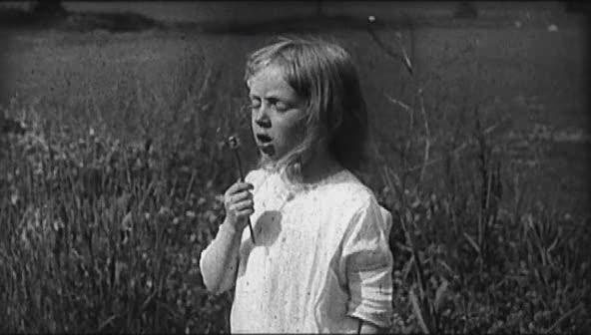
Video:
Our Investment of Blood
While viewing pay attention to Causes
After viewing: Group collaborates to fill in as many causes as possible on organizer

Slide 8
Reading: History Uncovered
Read the text with your group
p. 52 - Causes
How do the causes explained in the text compare to the causes you predicted?
Which cause do you think was most important? Why?
p. 53 - Consequences
Which consequences have the most impact on us today?
What connection is there between prohibition and our laws today?

Slide 9
Action: Rank and Write
Which is the most influential cause of prohibition?
Complete the Diamond Ranking Organizer
Write a paragraph explaining your choice of most influential cause.

Slide 10
Consolidation: Journal
Reflect on Causes
Which of my/our predicted causes were correct or incorrect? Why?

