Slide 1
Canada Enters World War I
‘READY AYE READY!’

Slide 2
Learning Goals
By the end of this lesson, students will be able to:
assess strength of Canada’s armed forces at the start of World War I
Describe the Canadian Government’s role in preparing Canada for war

Slide 3
Part I: recruitment

Slide 4
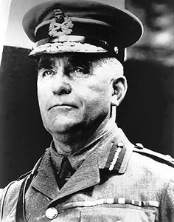
Raising an army
“Sir Sham Shoes”
At the start of the war, Canada had a small standing (regular, professional) army
Sam Hughes, the minister of Militia and Defense, was given the challenge of creating and training an overseas army
over 32,000 men volunteered in the first few months!!!
They did basic training at camp valcartier in Quebec
Hughes did a great job getting Canada’s army together, but…
Fired in 1916 for ‘Insubordination’
The Ross Rifle
Notes:
Volunteers in the beginning
Mention many saw themselves as British, parents are British
Small force, tremendous growth
3000 men

Slide 5
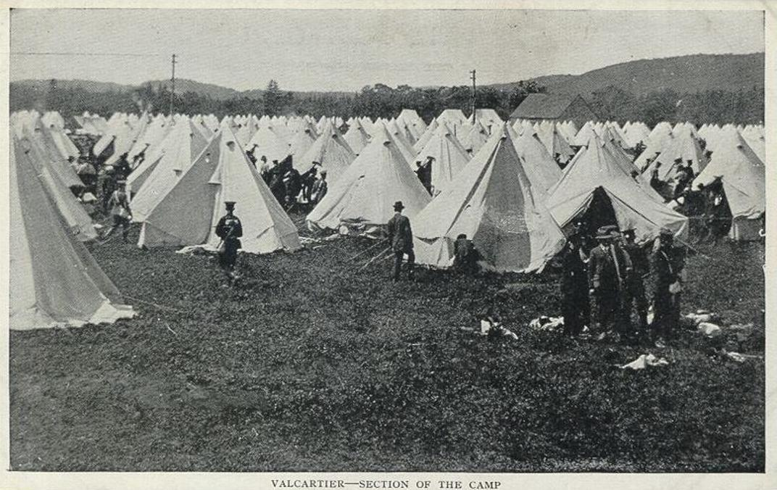
CAMP VALCARTIER, qUE

Slide 6
Hopes and dreams
At the start of the war Canada was experiencing a slowdown in the economy
Also a high unemployment rate
Many Canadians eager to enter the war as paid soldiers
Some dreamed of medals, honour
Others hoped to see new parts of the world
All thought they would be home by Christmas…

Slide 7
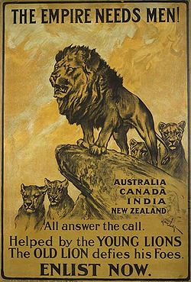
Government involvement
When Britain declared war on Germany, Canada was automatically at war!
The Canadian government quickly passed the War Measures Act
This law gave it control over virtually everything!
Transportation, manufacturing, immigration, civil rights were all strictly controlled
This is known as ‘total war’

Slide 8
The ‘Canadian expeditionary force’ (CEF)
Once Canadian troops were sent to England, they were put under the command of British Generals
These troops were said to be ‘unprepared, lacking discipline, and in possession of faulty equipment…’ – not a great start!!!
Canadian troops arrived during the rainy season in England – it rained for 89 of the first 120 days !
Morale and enthusiasm were very low during the first several months, troops were bored and discouraged – hungry for battle action!
In 1915, Canadians would be selected for our first test in Belgium at the Battle of Ypres

Slide 9
Stalemate
In the beginning of the war, the Germans experienced great success against the French and English forces
However, the German advance was stalled
As a result, both sides dug in and began building trenches
A 1000 kilometres of trenches and fortifications stretched across Europe and this became known as the West Front
Notes:
The machine gun led to this change in warfare
Schlieffen Plan
Stalemate: war of attrition

Slide 10
Trench Warfare
No Man’s Land: land between the two trenches
Over the top: infantry rising out of their trenches to assault the enemy
Artillery preceded any assault to soften up enemy defense
Then the men would go “over the top” and charge across No Man’s Land
goal was to capture and hold the enemies’ trenches
Notes:
Ask them if they see any faults with this type of warfare
Artillery soften enemy
Endless charges on highly defensible position
Why do you think it would be hard to gain ground
Talk about effect artillery had on land conditions and problems that came from them: mud, etc
Counter-attack

