Slide 1
Bringing home the constitution
Key Question: Did the charter make Canada stronger?

Slide 2
What is it?
THE CONSTITUTION

Slide 3
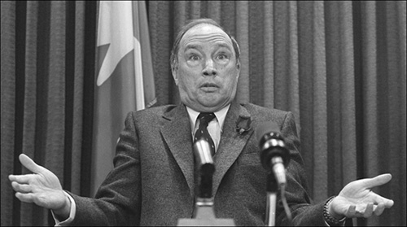
background
Before 1982, Canada’s constitution resided in Britain
We had to consult with GB on any major changes
Pierre Trudeau wants a ‘made-in-Canada’ version – and wanted to include a ‘Charter of Rights and Freedoms’ for Canadians
Not everyone was in favour…

Slide 4
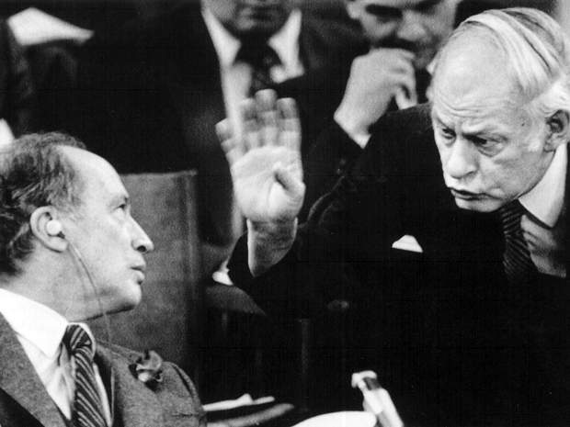
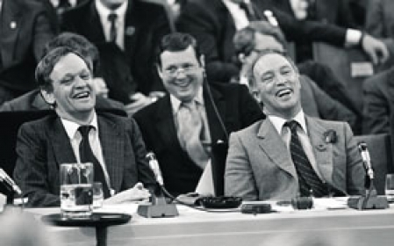
A picture says a thousand words…
How are these two photos different?

Slide 5
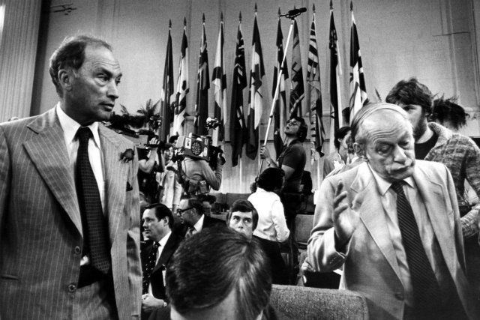
The negotiations…
Trudeau decides to try to convince the Premiers to allow it
They form an alliance against him – why?
They fear he will change the Constitution and take away some Provincial powers
Quebec is afraid it will be forgotten
See video:
https://www.youtube.com/watch?v=Ry-LENCrfiQ
(30:30)

Slide 6
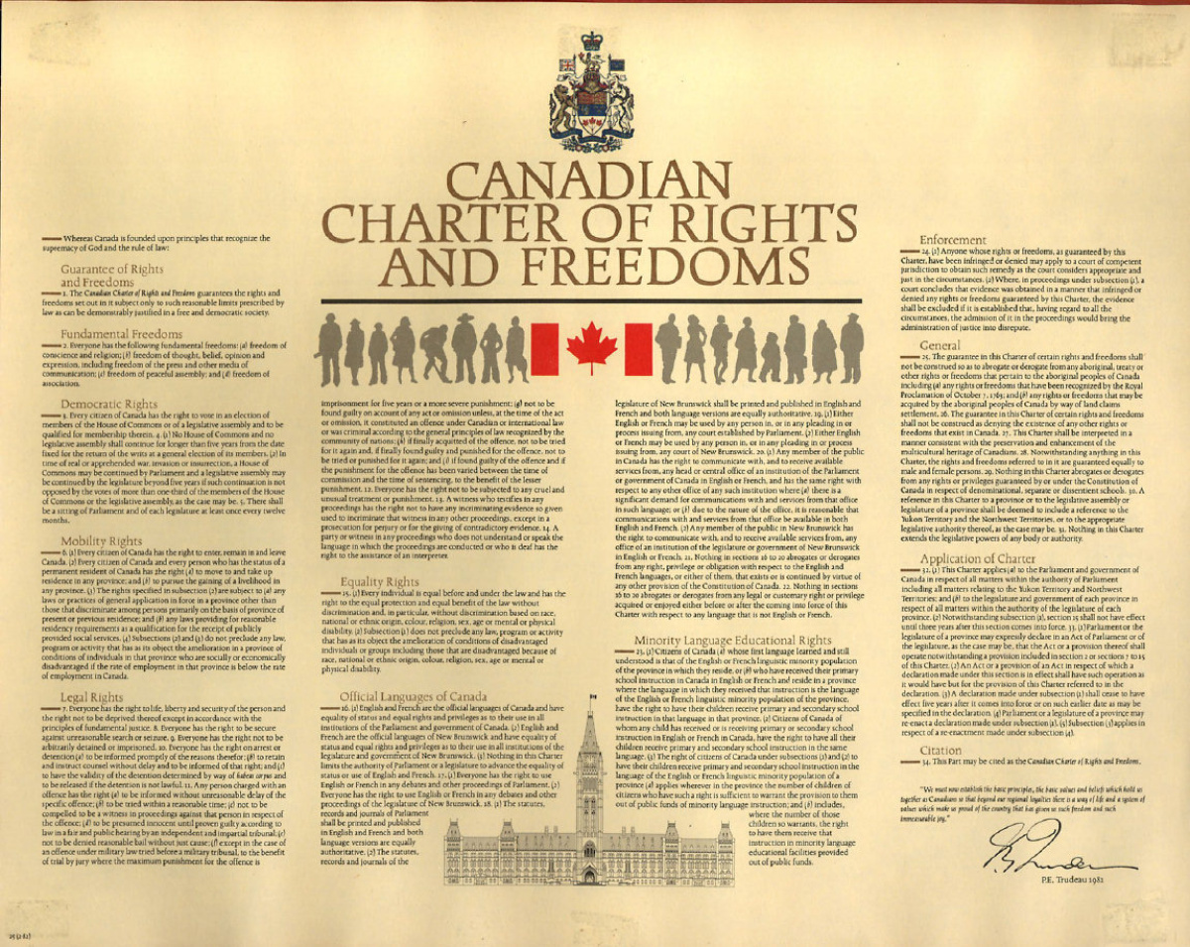
The Charter of rights and freedoms
The deal was signed – without Quebec’s permission
They still have not signed the Constitution to this day!
The Charter has transformed Canadian society in many ways…but was it good for Canada?
See handout

